Slide 1
Boolean Algebra

Slide 2
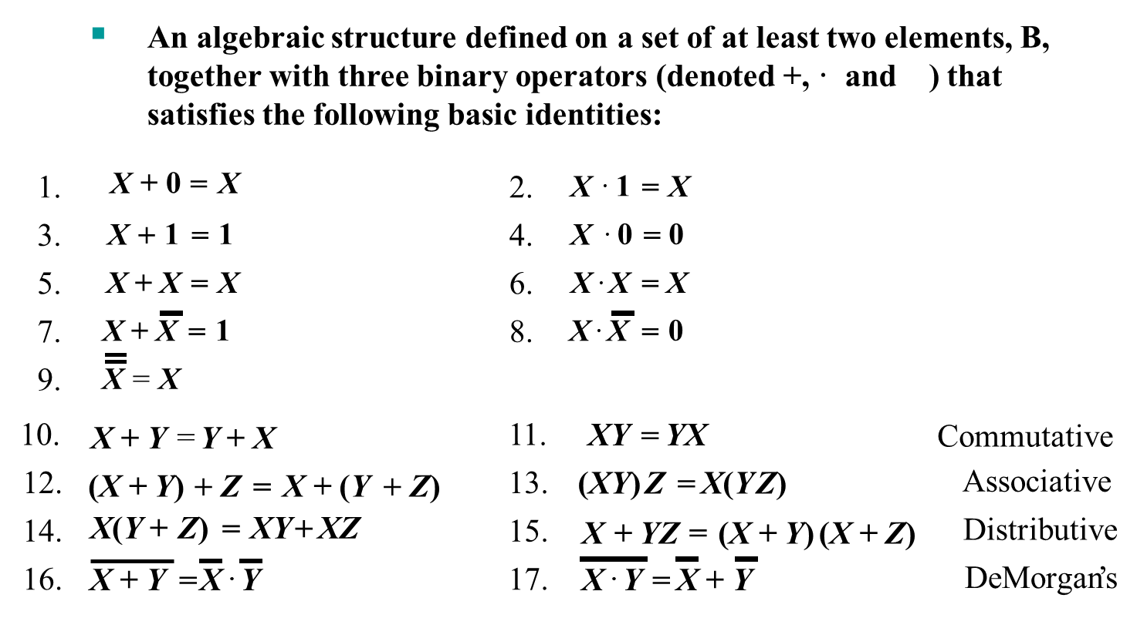
Boolean Algebra

Slide 3
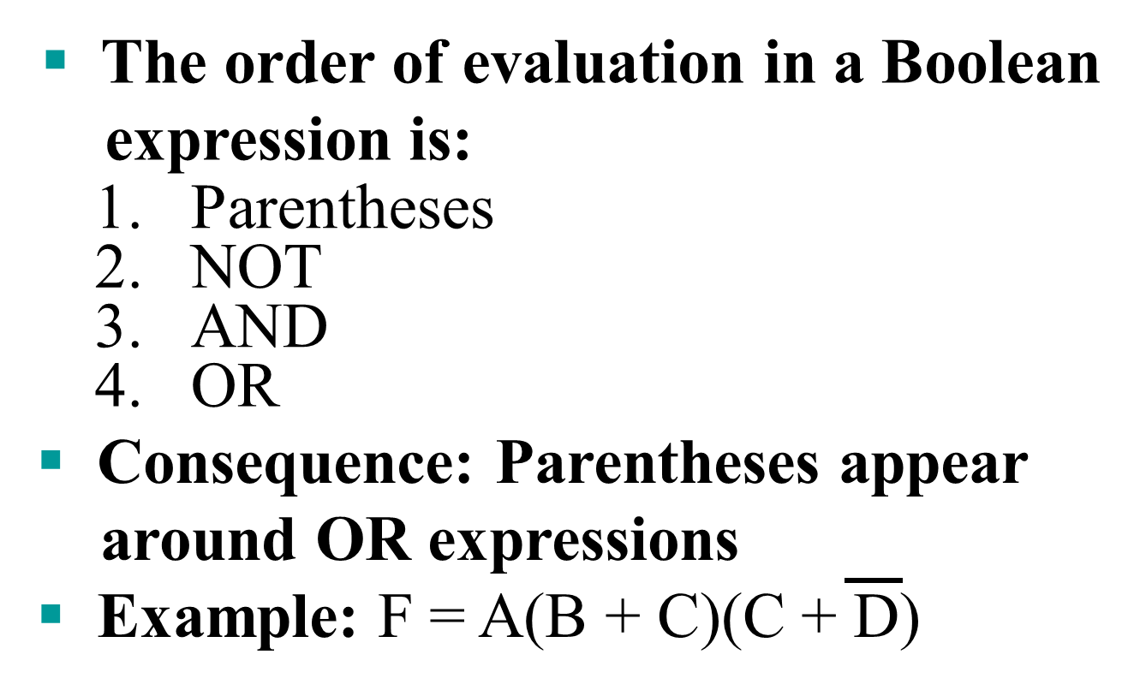
Boolean Operator Precedence

Slide 4
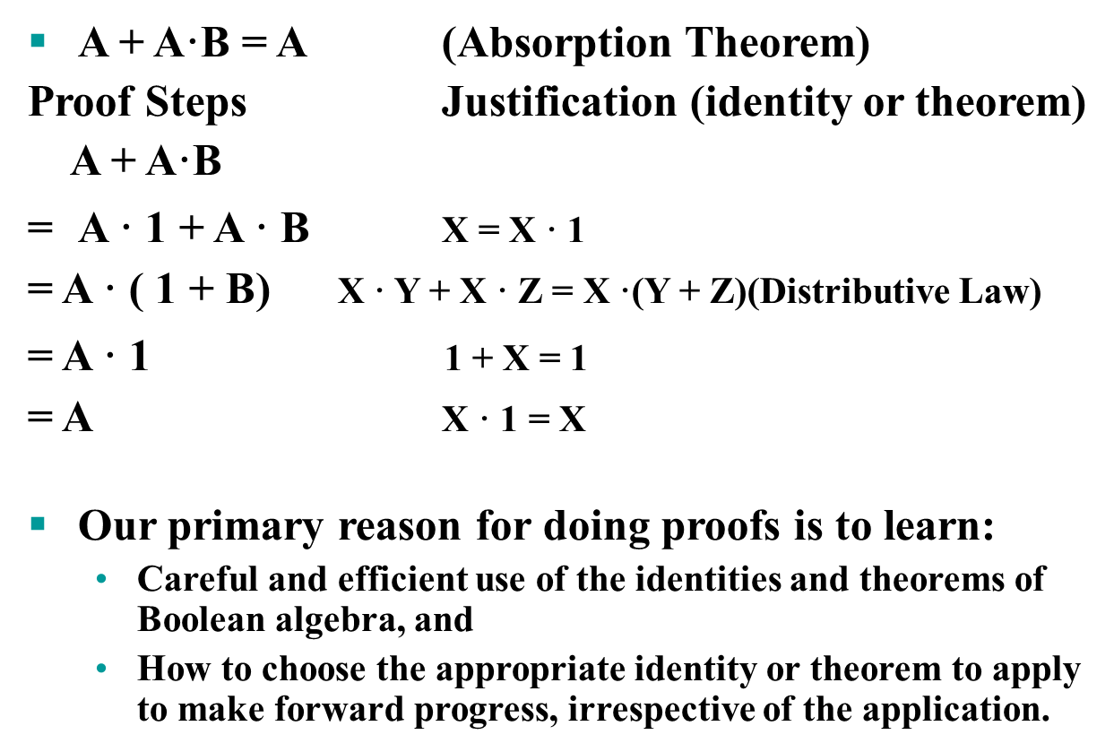
Example 1: Boolean Algebraic Proof

Slide 5
Example 2: Boolean Algebraic Proofs
AB + A’C + BC = AB + A’C (Consensus Theorem)
Proof Steps Justification (identity or theorem)
AB + A’C + BC
= AB + A’C + 1 · BC
= AB +A’C + (A + A’) · BC
= AB + A’C + ABC + A’BC
= AB + ABC + A’C + A’BC X + Y = Y + X (Commutative Law)
= AB . 1 + ABC + A’C . 1 + A’C . B X . 1 = X, X . Y = Y . X (Commutative Law)
= AB (1 + C) + A’C (1 + B) X(Y + Z) = XY +XZ (Distributive Law)
= AB . 1 + A’C . 1 = AB + A’C X . 1 = X

Slide 6
Proof of Simplification
x.y + x’.y = y (x + y)(x’ + y) = y
x . y + x’ . y
= (x ⁺ x’) . y X(Y + Z) = XY + XZ (Distributive Law)
= 1 . y X + X’ = 1
= y X . 1 = X

Slide 7
Overview – Canonical Forms
What are Canonical Forms?
Minterms and Maxterms
Index Representation of Minterms and Maxterms
Sum-of-Minterm (SOM) Representations
Product-of-Maxterm (POM) Representations
Representation of Complements of Functions
Conversions between Representations

Slide 8
What are Canonical Forms
It is useful to specify Boolean functions in a form that:
  Allows comparison for equality.
  Has a correspondence to the truth tables
Canonical Forms in common usage:
  Sum of Minterms (SOM)
  Product of Maxterms (POM)

Slide 9
Minterms
Minterms are AND terms with every variable present in either true or complemented form.
Given that each binary variable may appear normal (e.g., x) or complemented (e.g., ), there are 2^{n} minterms for n variables.
Example: Two variables (X and Y)produce 2 x 2 = 4 combinations:
  (both normal)
  (X normal, Y complemented)
  (X complemented, Y normal)
  (both complemented)
Thus there are four minterms of two variables.
XY
X
Y
X
Y
X
Y

Slide 10
Maxterms
Maxterms are OR terms with every variable in true or complemented form.
Given that each binary variable may appear normal (e.g., x) or complemented (e.g., x), there are 2^{n} maxterms for n variables.
Example: Two variables (X and Y) produce 2 x 2 = 4 combinations:
  (both normal)
  (x normal, y complemented)
  (x complemented, y normal)
  (both complemented)
X
+
Y
X
+
Y
X
+
Y
X
+
Y

Slide 11
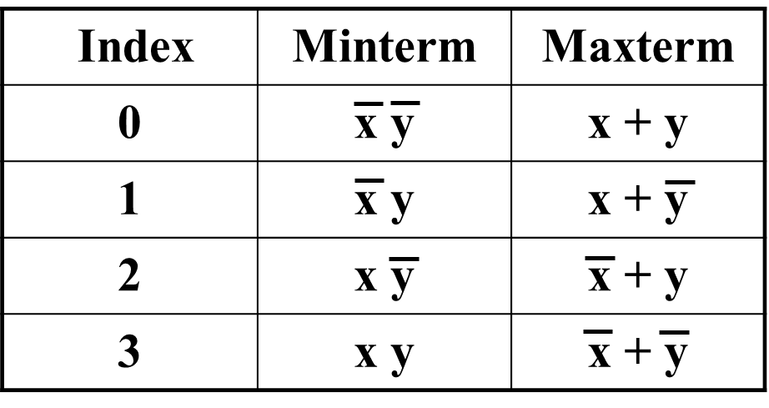
Maxterms and Minterms
Examples: Two variable minterms and maxterms.
The index above is important for describing which variables in the terms are true and which are complemented.

Slide 12
Purpose of the Index
The index for the minterm or maxterm, expressed as a binary number, is used to determine whether the variable is shown in the true form or complemented form.
For Minterms:
  “1” means the variable is “Not Complemented” and
  “0” means the variable is “Complemented”.
For Maxterms:
  “0” means the variable is “Not Complemented” and
  “1” means the variable is “Complemented”.

Slide 13
Index Example in Three Variables
Example: (for three variables)
Assume the variables are called X, Y, and Z.
The standard order is X, then Y, then Z.
The Index 0 (base 10) = 000 (base 2) for three variables). All three variables are complemented for minterm 0 ( ) and no variables are complemented for Maxterm 0 (X,Y,Z).
  Minterm 0, called m₀ is .
  Maxterm 0, called M₀ is (X + Y + Z).
  Minterm 6 ?
  Maxterm 6 ?
X
,
Y
,
Z
X
Y
Z

Slide 14
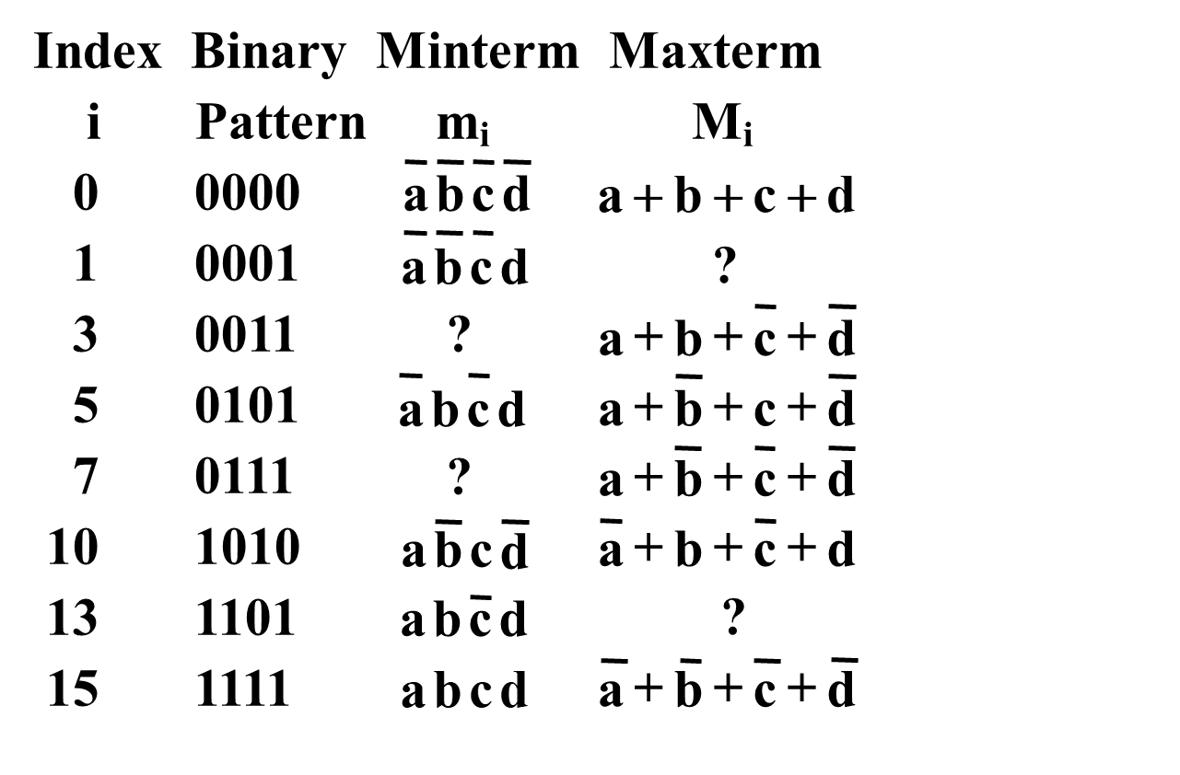
Index Examples – Four Variables

Slide 15
Minterm and Maxterm Relationship
Can you establish?

